Slide 1
Clustering Prediction Model for Global Development Measurement Data using Machine Learning
Group Members
Mr.Rajendra Kumar Chekuri.
Mrs.Priyanka Prashant Ranawade
Mr.Rathan Nayaka C.
Mr.Sanath N S
Mr.Prajwal babu
Mr.Rakesh A
Mr.Abdulrahman Shaik

Slide 2
Introduction:
This report provides an overview of the process flow used to develop a clustering prediction model for global deveolopment measurement dataset.
The purpose of this report is to outline the steps taken and the results obtained during the development of the model.
Objective of the Project : Creating clusters on global development measurement dataset
Dataset Details:
Variable Description:
Birth Rate, Business tax, CO2emissions, Country, Days to start business, Ease of business, energy usage, GDP, healthexp%GDP, healthexp/capita, hours to do tax, infant mortality, internet usage, lending rate, life expectancy female, etc.
The dataset consisted of 2704 rows and 25 features

Slide 3
EDA & Data Preprocessing
The data was explored to get insights and found different patterns.
Cleaned data to handle strings & special Characters in the data
Data types corrected,
The data was pre-processed to handle missing values by using KNN imputer

Slide 4
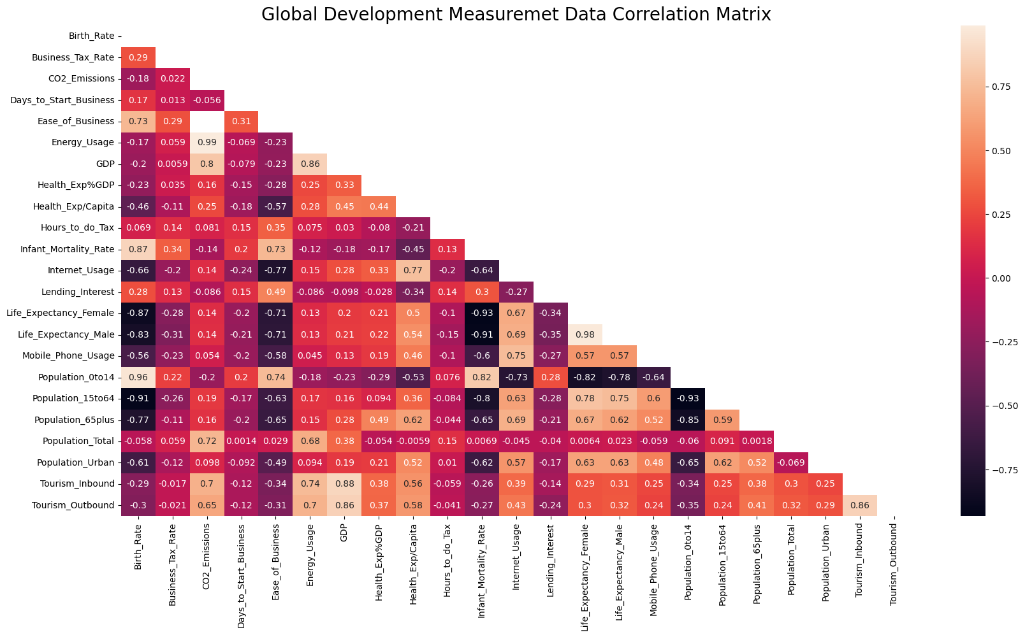
Correlation Matrix Heatmap

Slide 5
Key Insights and Patterns from Correlation matrix of Heatmap:
Energy Usage and CO2 Emissions are highly positively correlated(r=0.99), The Energy generated through coal, natural gas, petroleum & fossil fuel causes high CO2 Emissions
Strong Positive correlation(r=0.96) between Population of 0 to 14 and the Birth Rate, in general the population from 0 to 14 directly depends on Birth Rate. If the Birth_Rate increases the Population from 0 to 14 increases, vice versa.
Highly Negative correlation(r=-0.93) between Life Expectancy Female and Infant Mortality Rate & (r=-0.91) Life Expectancy Male and Infant Mortality Rate, Life expectancy of both male and female highly affected by infant mortality.
Tourism Inbound, Outbound are positively correlated with GDP respectively 0.88 & 0.86.

Slide 6
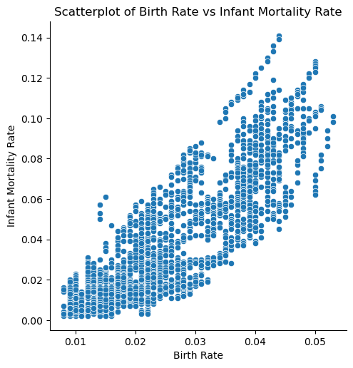
Scatterplot of Birth Rate vs Infant Mortality Rate
The data points are overlapping and not scattered much, it means that there is a strong positive linear relationship between Birth Rate and Infant Mortality Rate.

Slide 7
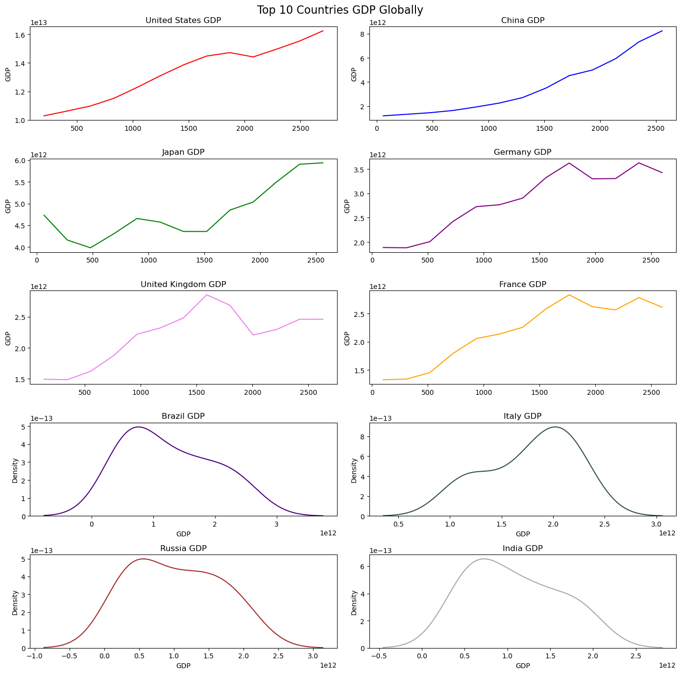
Top 10 Countries GDP Globally

Slide 8
Key Insights from Top 10 GDP Countries Line Plot
The countries GDP line plots are not constant, GDP for the countries has a clear trend
We can observe that the countries United States, China, Japan , Germany, United kingdom & France are having clear increasing trend
Brazil, Italy, Russia and India are having decreasing Trend over a period of time
We can conclude that the data has a clear trend, its a time series data

Slide 9
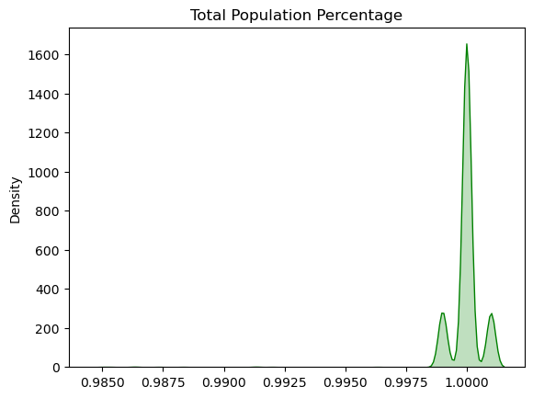
Total Population Percentage
Key Insights from the above KDE plot:
We have unveiled the pattern that the sum of the Population from 0-14 & 15-64 & 64+ are equals to 1
After imputing the missing values we can observe that the data is lying in between 0.999 to 1.0010, hence we can say that we have imputed the missing data successfully without any deviation

Slide 10
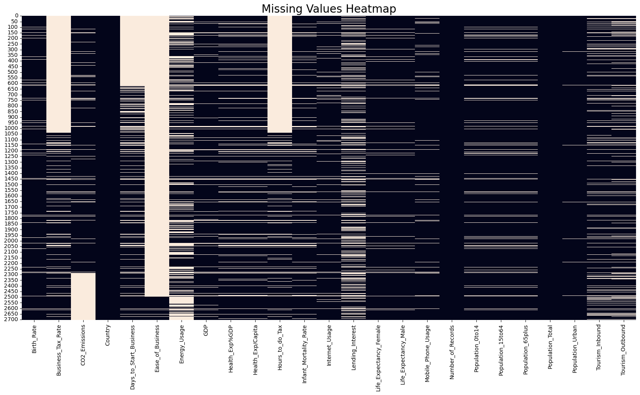
Heatmap of Missing Values

Slide 11
Missing Values Details
The data set has many missing values
Ease of doing business has highest missing values, followed by Hours to do tax & Business Tax Rate
Country, Number of Records & Total Population are the only features which doesnt have any missing values
Birth_Rate : 4.4 Business_Tax_Rate : 47.37
CO2_Emissions : 21.41 Days_to_Start_Business : 36.46
Ease_of_Business : 93.16 Energy_Usage : 33.99
GDP : 7.77 Health_Exp%GDP : 11.43
Health_Exp/Capita : 11.43 Hours_to_do_Tax : 47.63
Infant_Mortality_Rate : 9.62 Internet_Usage : 6.4
Lending_Interest : 30.47 Life_Expectancy_Female : 5.03
Life_Expectancy_Male : 5.03 Mobile_Phone_Usage : 6.18
Population_0to14 : 8.14 Population_15to64 : 8.14
Population_65plus : 8.14 Population_Total : 0.0
Population_Urban : 0.96 Tourism_Inbound : 13.61
Tourism_Outbound : 17.42 Country : 0.0

Slide 12
Handling Missing Values
Removed features which are haaving more than 30 % of missing values
Imputed missing values by using KNN imputer
Removed Features are :
Number of Records
Ease of Business
Business_Tax_Rate
Hours_to_do_Tax
Days_to_Start_Business
Lending_Interest
Health_Exp/Capita
Treated Outliers with IQR & Scaled data by using MinMax Scaler

Slide 13
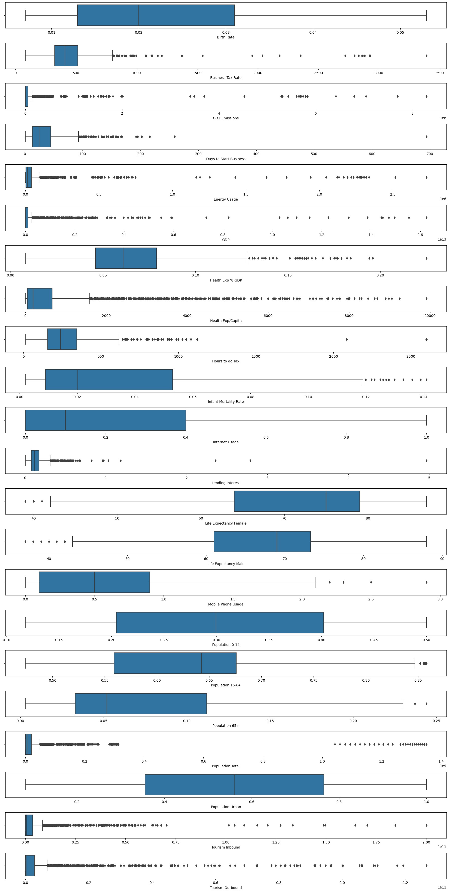
Outlier detection

Slide 14
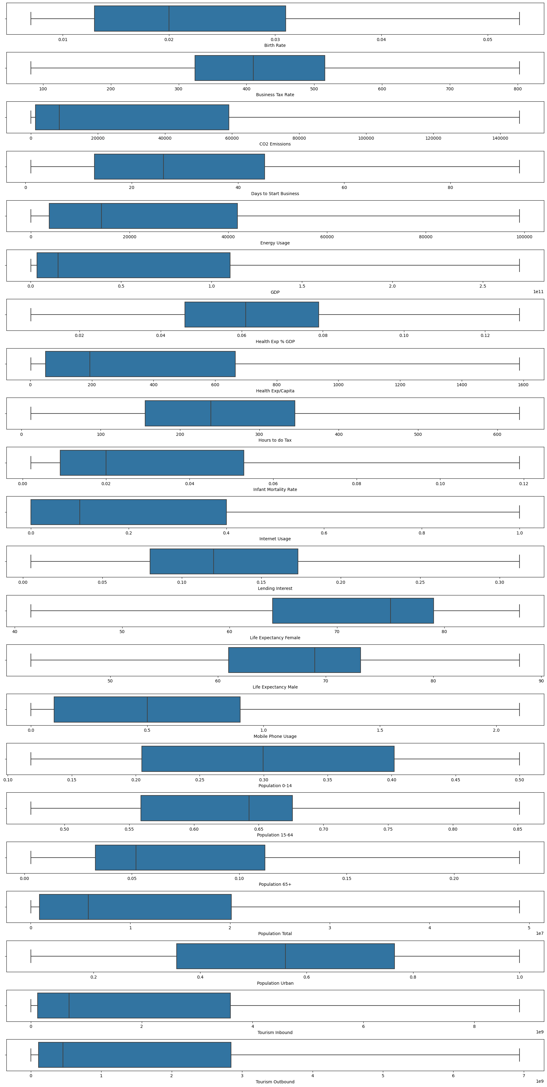
Removing outlier with IQR

Slide 15
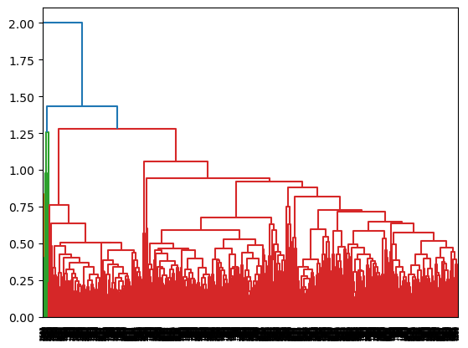
Dendogram by average linkage
From the above Dendogram we can observe that the clusters are overlapped

Slide 16
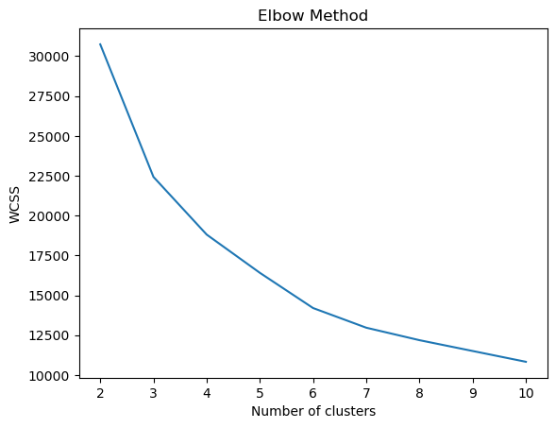
Elbow Method(KMeans)
From the plot we can observe that the line flattened after third cluster, so the optimum number of clusters k=3

Slide 17
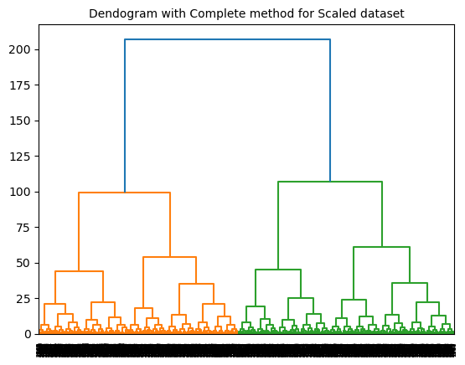
Dendogram for Scaled Data with Complete method

Slide 18
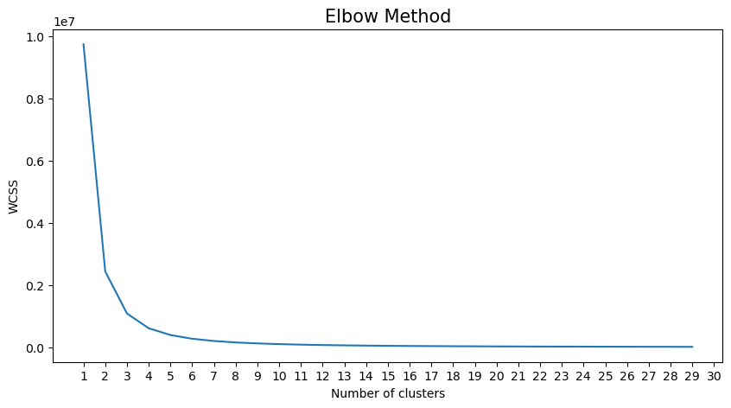
Elbow Method( KMeans ) for Scaled Data
Key Insights from the Above Plot:
We can observe that the most of the variance is covered with 4 clusters
There is not much variance in the plot after 4rth cluster, the line almost flattened through the all remaining clusters

Slide 19
Model Selection:
I have selected KMeans clustering as the best model for the given data set.
The model divided the into 6 clusters
Model evaluation:
Evaluated the model & measuring its calculated Silhouette Score
The model has got Silhouette Score as 0.43
Code:
Jupyter Notebook: used for EDA & data preprocessing and interpretation and data Visualizations & builidng model
Spyder: Used Spyder for building Final Model & Model Deployment by using streamlit

Slide 20
Thank You

Slide 21
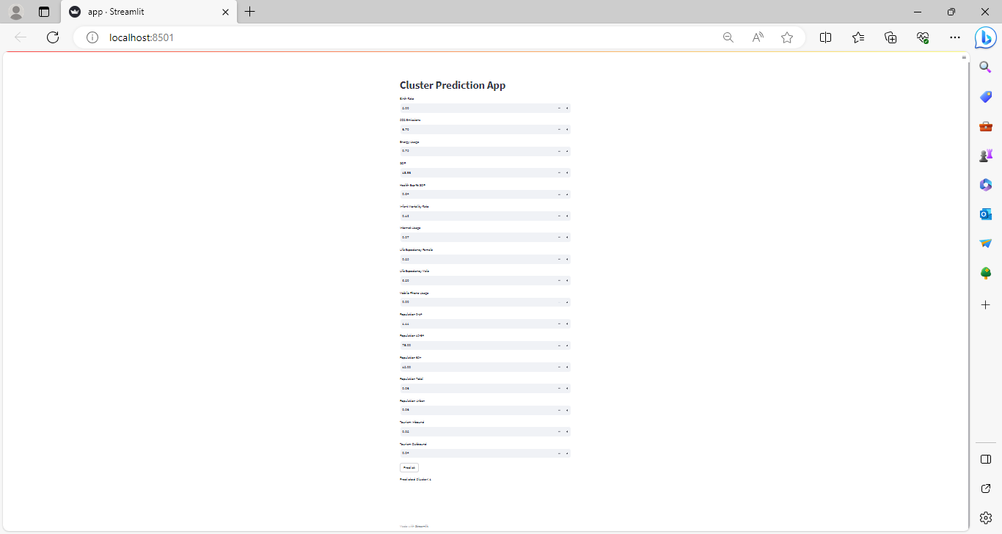
Project Deployment

